Slide 1


The RI SQL Server User Group
&
The RI Business Intelligence User Group
http://www.sqlsaturday.com/694/EventHome.aspx
Use Discount Code
Microsoft
For 20% Off
Pre Con: R Programming from A to Z
https://r_programming.eventbrite.com

Slide 2


Bryan Cafferky
Data Solutions Consultant and Trainer with BPC Global Solutions LLC
Microsoft MVP
Decades of IT experience
Author of Pro PowerShell for Database Developers by Apress
SQL PASS Chapter Lead
Lead the Southern New England UseR Group
@bryancafferky
linkedin.com/in/bryancafferky/
bryan256@msn.com

Slide 3


ADFv2 – Azure at Warp Speed
Azure
Bryan Cafferky
BPC Global Solutions LLC

Slide 4
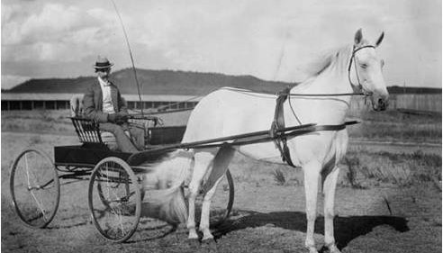

Slide 5
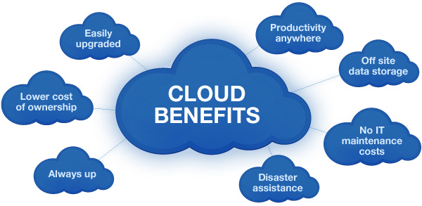

Slide 6
What’s Ahead?
Setting the Context - Platform as a Service (SQL Server)
Highlights of Azure Data Factory v2
SSIS Packages on Azure
Lessons Learned
ADF Road Map
Take-A-Ways

Slide 7

Platform as a Service Value Proposition
You Focus on Business
We’ll Provide the Means
Easy to Set Up and Use Services
No Messy Hardware to Manage
Scale As Needed

Slide 8
SQL Server Offered as Services

Slide 9

SQL Server Stack Mapped to Azure Services
d
On Premise
SQL Server Stack
SQL Server
Managed Instance
Database Engine
SQL Database
Integration Services
SQL Data Warehouse
Analysis Services
ADFv2 SSIS
Reporting Services
Analysis Services
?

Slide 10
SQL Server Managed Instance
Filling Out the Puzzle

Slide 11
SQL Server Managed Instance
Soon Public Preview
SQL Agent
Common Runtime Library
Linked Servers
Missing: Reporting Services
Schedule ADF SSIS Packages
https://www.youtube.com/watch?v=-f_9gScnEB4

Slide 12
What is SQL Database Managed Instance?
SQL Database (PaaS)
A flavor of SQL DB designed to enable easy migration to fully managed PaaS, for almost any application!
Managed Instance
Singleton
Elastic Pool
Easy lift and shift
Fully managed PaaS
Full isolation and security
New business model
Fully-fledged SQL instance with nearly 100% compat with on-prem
Built on the same PaaS service infrastructure
All PaaS features
Native VNET implementation
Private IP addresses
Competitive
Transparent
Frictionless

Slide 13
Easy migration: nearly 100% like SQL Server
Data migration
Native backup/restore
Log shipping (DMS)
Security
TDE
SQL Audit
Row level security
Always Encrypted
Programmability
Global temp tables
Cross-database queries and transactions
Linked servers
CLR modules
Operational
DMVs & XEvents
Query Store
SQL Agent
DB Mail (external SMTP)
Scenario enablers
Service Broker
Change Data Capture
Transactional Repl
Note: features will be added in stages until General Availability of Managed Instance

Slide 14
Up Next
SSIS On Azure

Slide 15
Azure Data Factory v2

Slide 16
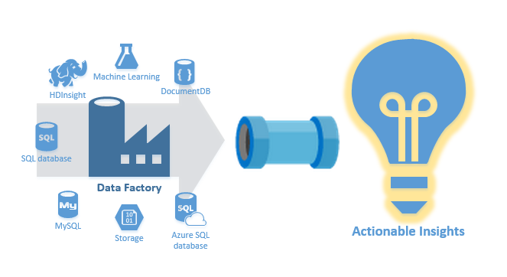
Azure Data Factory v2
Cosmos DB
SSIS
ADF

Slide 17
Highlights of ADF v2: New
Hybrid Data Integration Service.
Web Based Developer User Interface
Expressions and Parameters
System Variables
Inline Pipeline
Event and Scheduled Triggers
Parts Borrowed from the Excellent Blog by Paul Andrew – link below…
https://www.purplefrogsystems.com/paul/2017/09/whats-new-in-azure-data-factory-version-2-adfv2/

Slide 18
Highlights of ADF v2: What You Need
Azure Feature Pack – New SSIS Tasks
SSMS 2017
SSDT 2017
https://docs.microsoft.com/en-us/sql/ssdt/download-sql-server-data-tools-ssdt

Slide 19
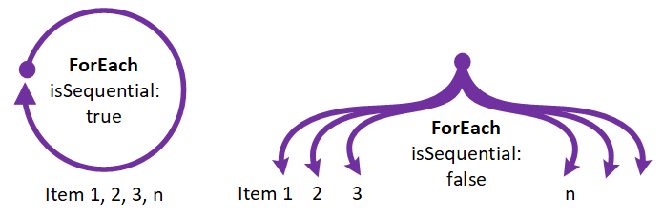
Azure Feature Pack
Copy Support for Dynamics 365, Dynamics CRM, and Salesforce
Custom Activity Code Can Pass Back Reference Objects
For Each Loop
Simplified Web (Rest API) – JSON
Call Web Service Directly from Pipelines
Lookup Datasets / Copy Operation
Depends On Activity Execution
Azure Monitor / OMS View ADFv2 Logs
Workflow

Slide 20
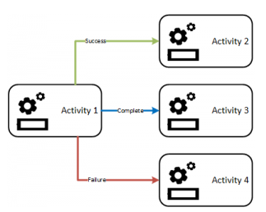
Highlights: Concepts
Branching
On success
On failure
On completion
On skip
Support for conditional expressions

Slide 21
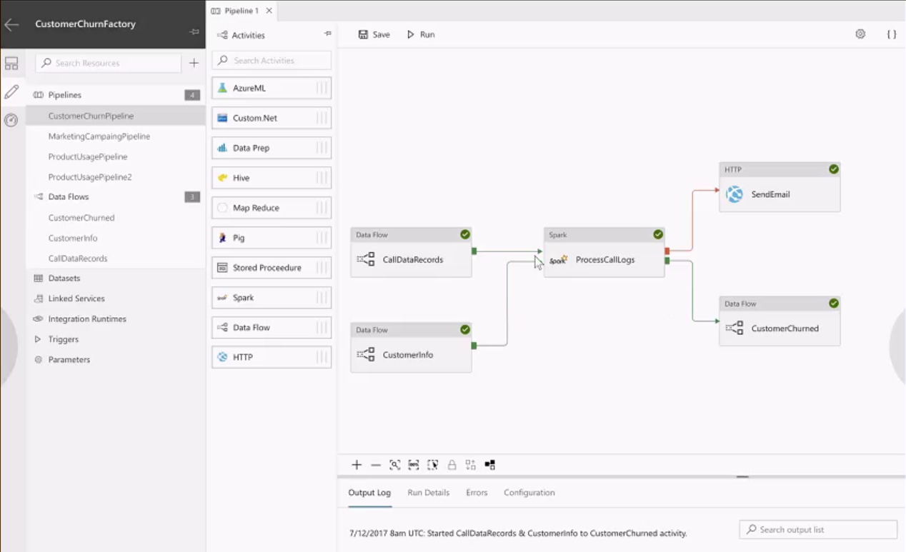
ADF Activities: Web Based User Interface

Slide 22
Azure Feature Pack in SSDT

Slide 23
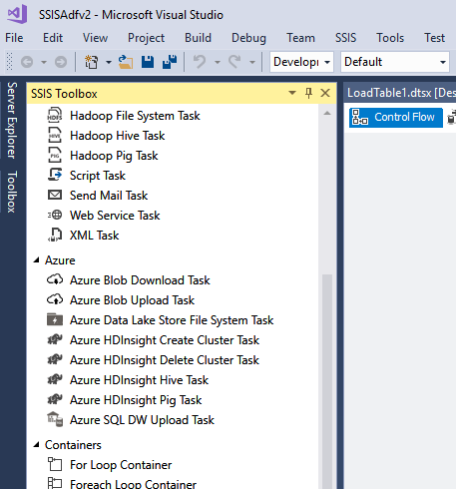
Azure Feature Pack SSIS Tasks
Azure Tasks

Slide 24
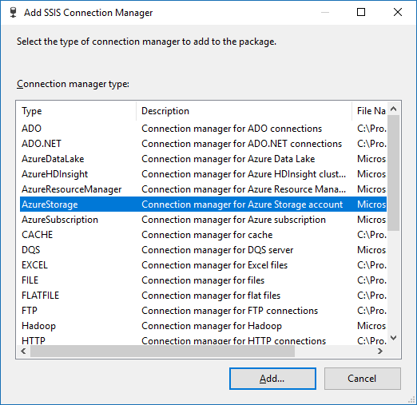
Azure Feature Pack SSIS Tasks
Azure Storage

Slide 25
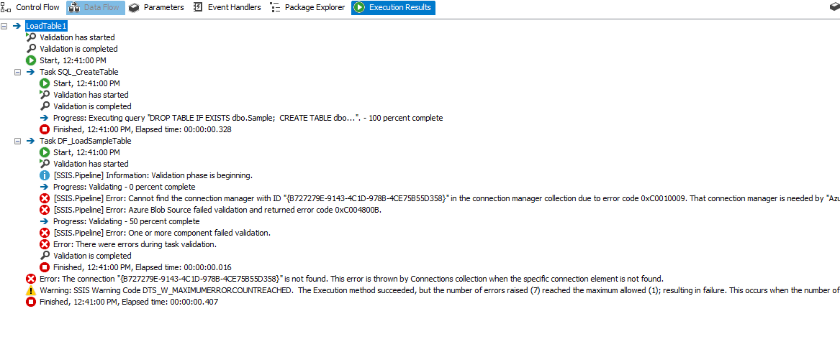
Azure Feature Pack SSIS Tasks
SSDT and SSMD Client Side Error
Azure Storage
Connection Manager Not Found
Works on Azure though?

Slide 26
SSIS on Azure

Slide 27

ADFv2 / SSIS Architecture
Azure Data Factory v2
SSIS Integration Runtime
Azure SQL Server
Integration Services Catalog
SSISDB
SSIS Integration Runtime
Automatically Created with IR
Azure
On Premise
SSMS
SSDT
* Only SSIS 2012 or Later Supported

Slide 28
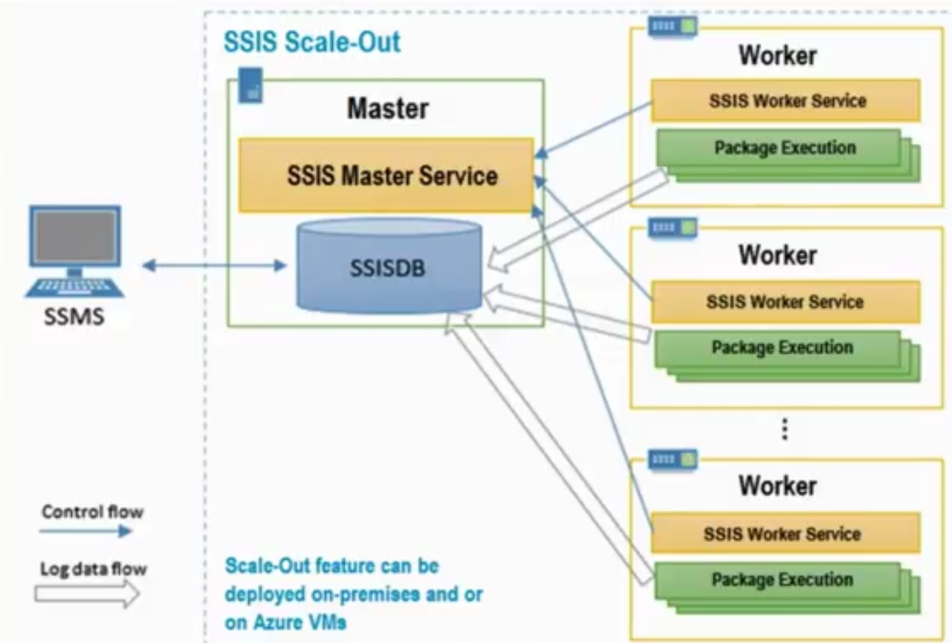
SSIS 2017 Scale Out
Scale Out On Prem or on Azure.
Master Hosts SSISDB and Master Service.
Worker Hosts Worker Service and SSIS Engine.
Master Service Distributes Packages to Workers.
Master and Workers Communicate Over Secured Sockets Layer (SSL).
License Requirements for each node.
https://www.mssqltips.com/sqlservertip/4943/execute-ssis-package-in-scale-out-mode--sql-server-2017/

Slide 29


Slide 30
SSIS Lift & Shift (On Prem to Azure)
Create a SQL Server Instance
Create Firewall rule for client ip addresses
Enable Azure Services to Access the SQL Server Instance
Create a Azure Data Factory
Create an Integration Runtime
Creates the SSISDB database in the SQL Server Instance

Slide 31
Concepts
Integration Run Time (IR)
Execute SSIS Packages
Execute ADF Activities (Major New Features)
Scale Out – Azure Managed or On Premise

Slide 32
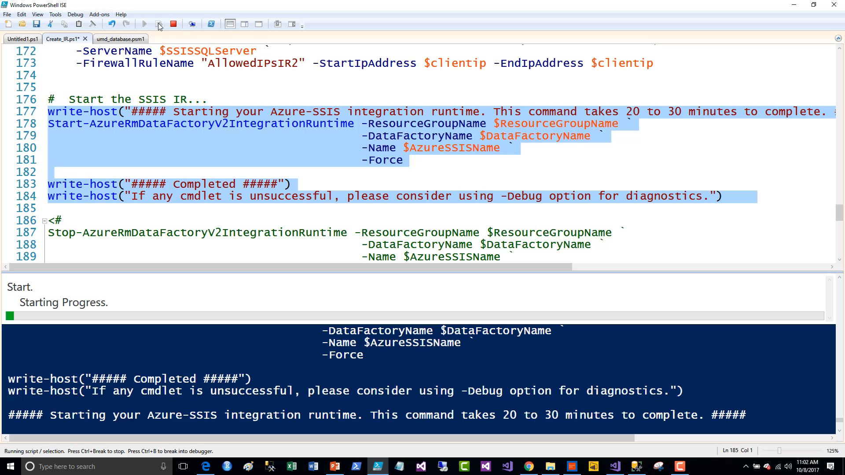
Demo – Creating the Resources
Creating the Integration Runtime Video…

Slide 33
Demo Review

Slide 34
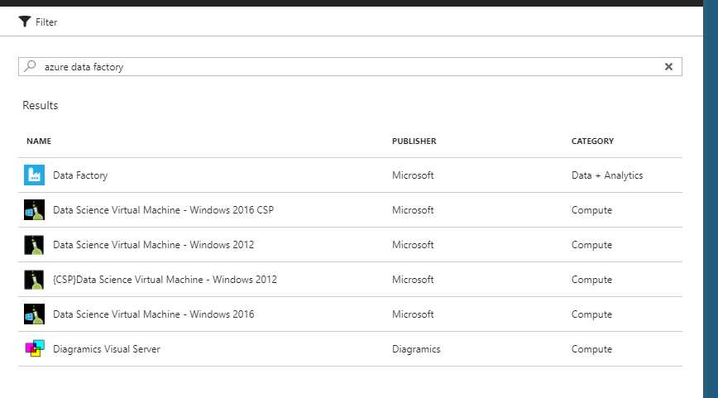
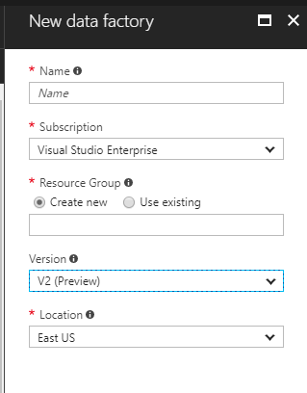
Create an Azure Data Factory
SSIS
ADF
V2 (Preview)

Slide 35
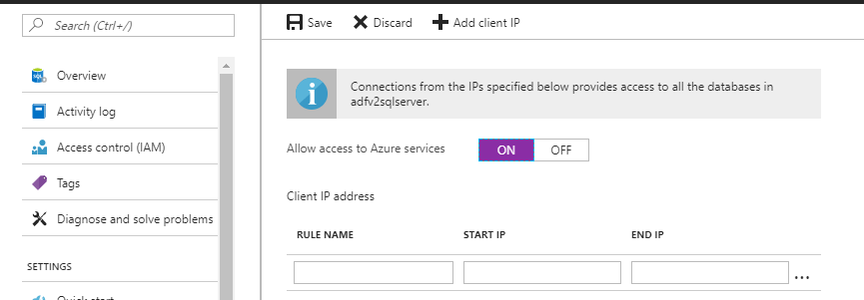
Enabling Azure Services to Access SQL Server

Slide 36
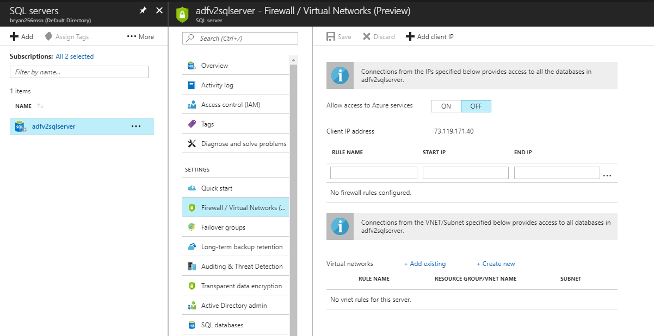
Enabling Fire Wall Rule
Enable
88.777.666.55
Client IP Address

Slide 37
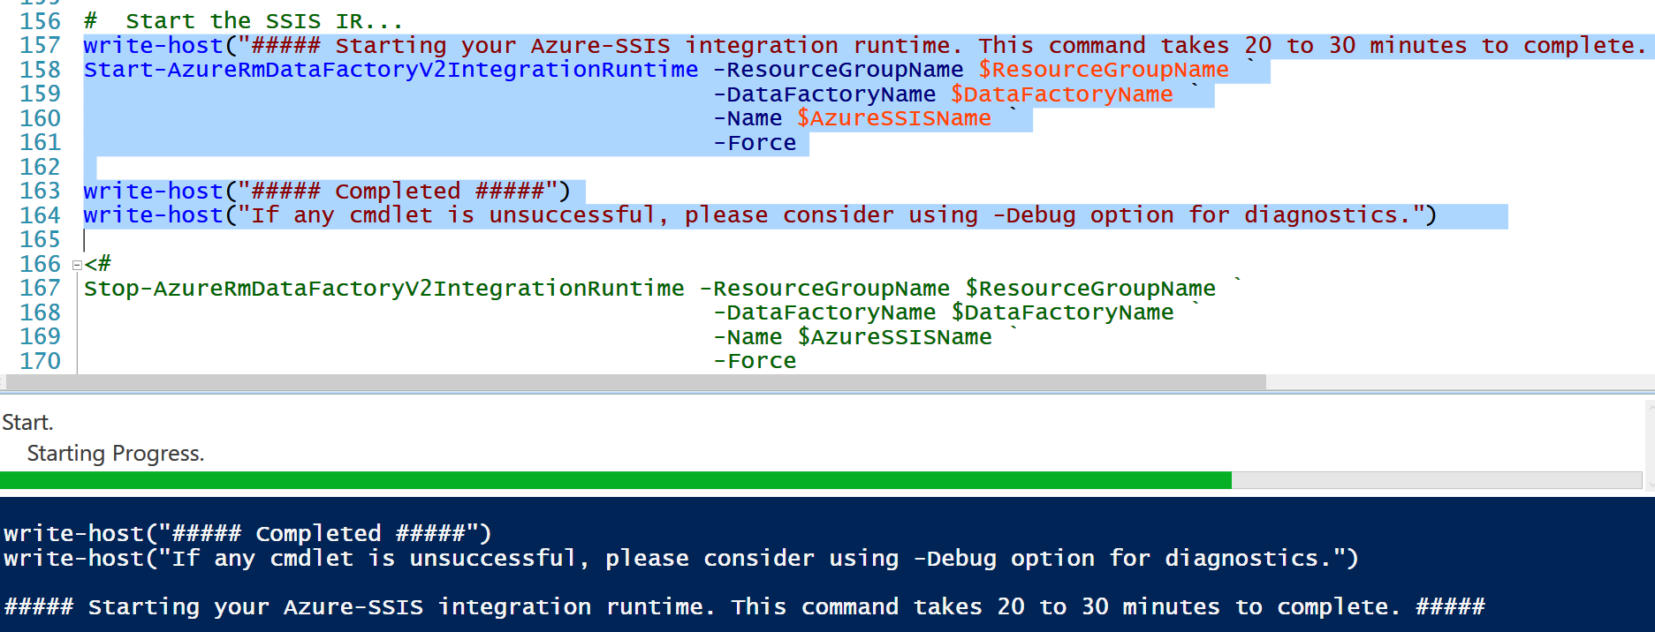
Creating the IR

Slide 38
ADFv2 Links
Full Feature Presentation
https://www.youtube.com/watch?v=8iUv9Cqbuew
Documentation
https://docs.microsoft.com/en-us/azure/data-factory/
Azure Feature Pack SQL Server 2017
https://www.microsoft.com/en-us/download/details.aspx?id=54798&e6b34bbe-475b-1abd-2c51-b5034bcdd6d2=True

Slide 39
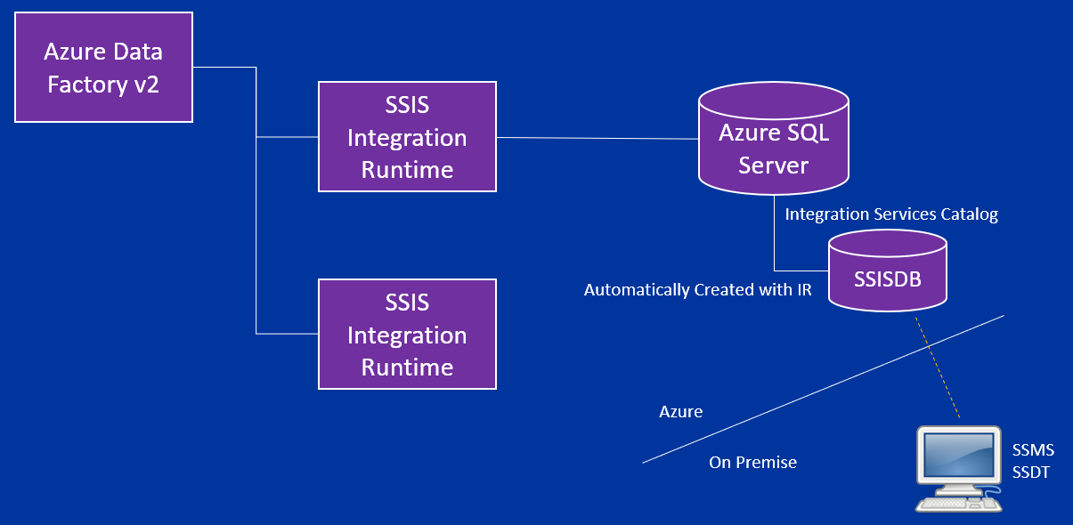
Azure Data Factory v2 – Part 1
Q & A

Slide 40
Azure Data Factory v2 – Part 2
Next

Slide 41


Slide 42
Why is Spock’s shirt blue in Star Trek The Original Series?

Slide 43
Why is Spock’s shirt blue in Star Trek The Original Series?
Blue stands for Science and Medical Service.

Slide 44
What was the first object orientated programming language and when was it released?

Slide 45
What was the first object orientated programming language and when was it released?
SIMULA 67 was formally standardized 1968. Simula was influential in the development of Smalltalk and later object-oriented programming languages.

Slide 46

It was rumored that the Apple logo was in honor of this pioneer of Computer Science.

Slide 47
It was rumored that the Apple logo was in honor of this pioneer of Computer Science.
Alan Turing – an apple with a bite out of it was found next to him.

Slide 48
What was an Enigma Machine and why is it important to computer history?

Slide 49
What was an Enigma Machine and why is it important to computer history?
An encryption device used by the Germans in WWII to
communicate securely. Alan Turing of Britain
led development of the first computer that was used
to break the Enigma code.

Slide 50
Azure Data Factory v2 – The Sequel
SSIS On Azure

Slide 51
Review: SSIS Lift & Shift (On Prem to Azure)
Create a SQL Server Instance
Create Firewall rule for client ip addresses
Enable Azure Services to Access the SQL Serverf Instance
Create a Azure Data Factory
Create an Integrated Runtime
Creates the SSISDB database in the SQL Server Instance

Slide 52
ADFv2 SSIS Demo
Connect to the Integration Services Catalog using SSMS
Use SQL Server Data Tools (SSDT) to Deploy a Project to Azure
Use SSMS to Review the Deployed Project and Run the Packages
Deploy a Project from SQL Server On Premise to Azure using SSMS

Slide 53
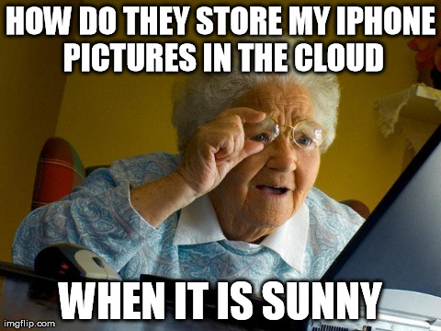

Slide 54
Issues Encountered

Slide 55
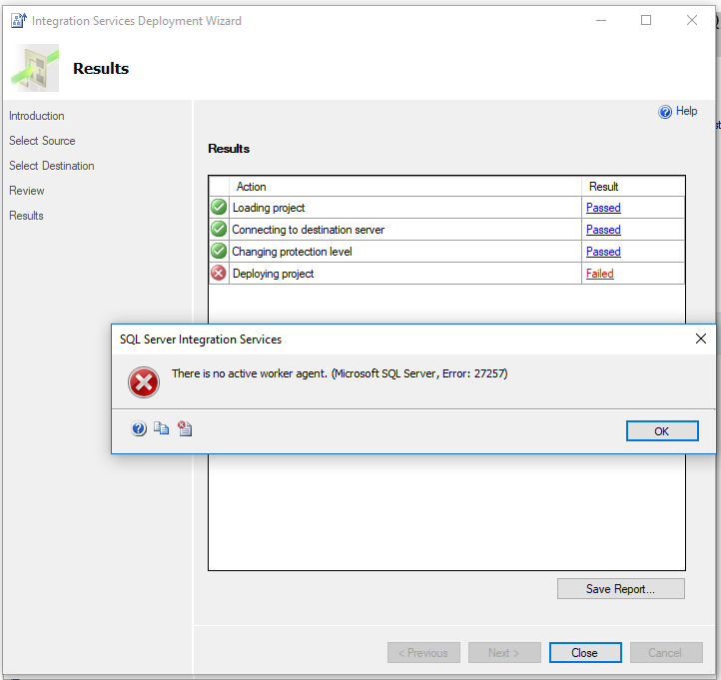
SSIS Catalog with Inactive IR
After Stopping
an Integrated
Runtime
Can connect but NOT deploy.
Start the IR.
Start-AzureRmDataFactoryV2IntegrationRuntime

Slide 56
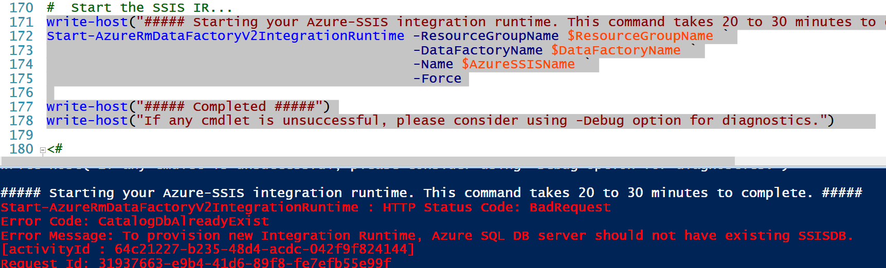
Restarting an Existing IR
Delete the Old SSISDB

Slide 57
Removing SSIS Integration Runtime (IR)
Remove Resources in Reverse Order of How They Were Created
SSIS Integration Runtime
Data Factory
SSISDB
SQL Server (If no other databases exist)

Slide 58
Removing SSIS Integration Runtime (IR)
Demo

Slide 59
Looking Ahead

Slide 60
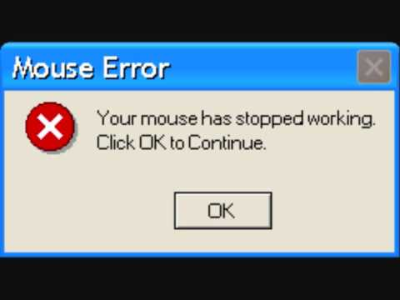

Slide 61
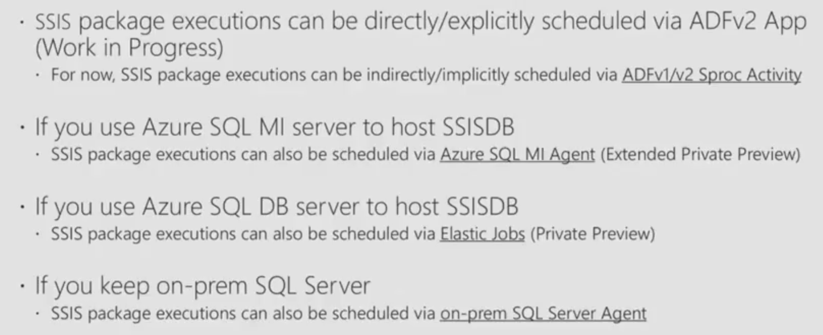
SSIS Package Scheduling Options (Planned)

Slide 62
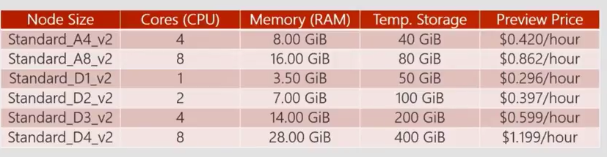
Pricing
Information as per Ignite 2017 presentation at the link: https://www.youtube.com/watch?v=8iUv9Cqbuew

Slide 63
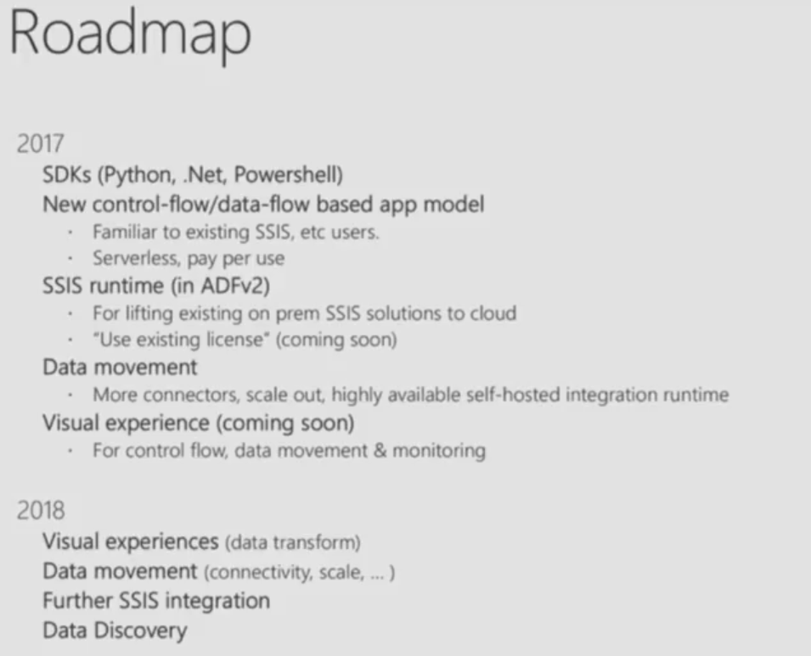
SSIS Package Scheduling Options
Information as per Ignite 2017 presentation at the link: https://myignite.microsoft.com/sessions/55271

Slide 64
Lessons Learned
Test New Functionality with Test Subscriptions
Carefully Test Out the Cost of Resources
Automate with PowerShell from the Start
Explore and Test Client Tools Functionality
Integration Runtime Still Hidden in the Azure Portal UI
Remove After Playing Around $$$

Slide 65
Take-A-Ways
Resistance Is Futile: Embrace the Cloud
Eventually Almost Everything Will Be Offered as a Service (PaaS)
Migrating SSIS Packages to Azure as a Service is Now Possible
Azure Data Factory Pipelines are the ETL Next Generation
ADF/SSIS Are Now Highly Scalable
Evaluate the Pricing Carefully

Slide 66

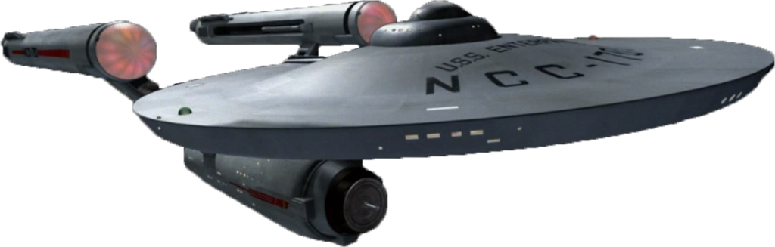

Closing: Q & A
Azure Data Factory
Azure

